Slide 1
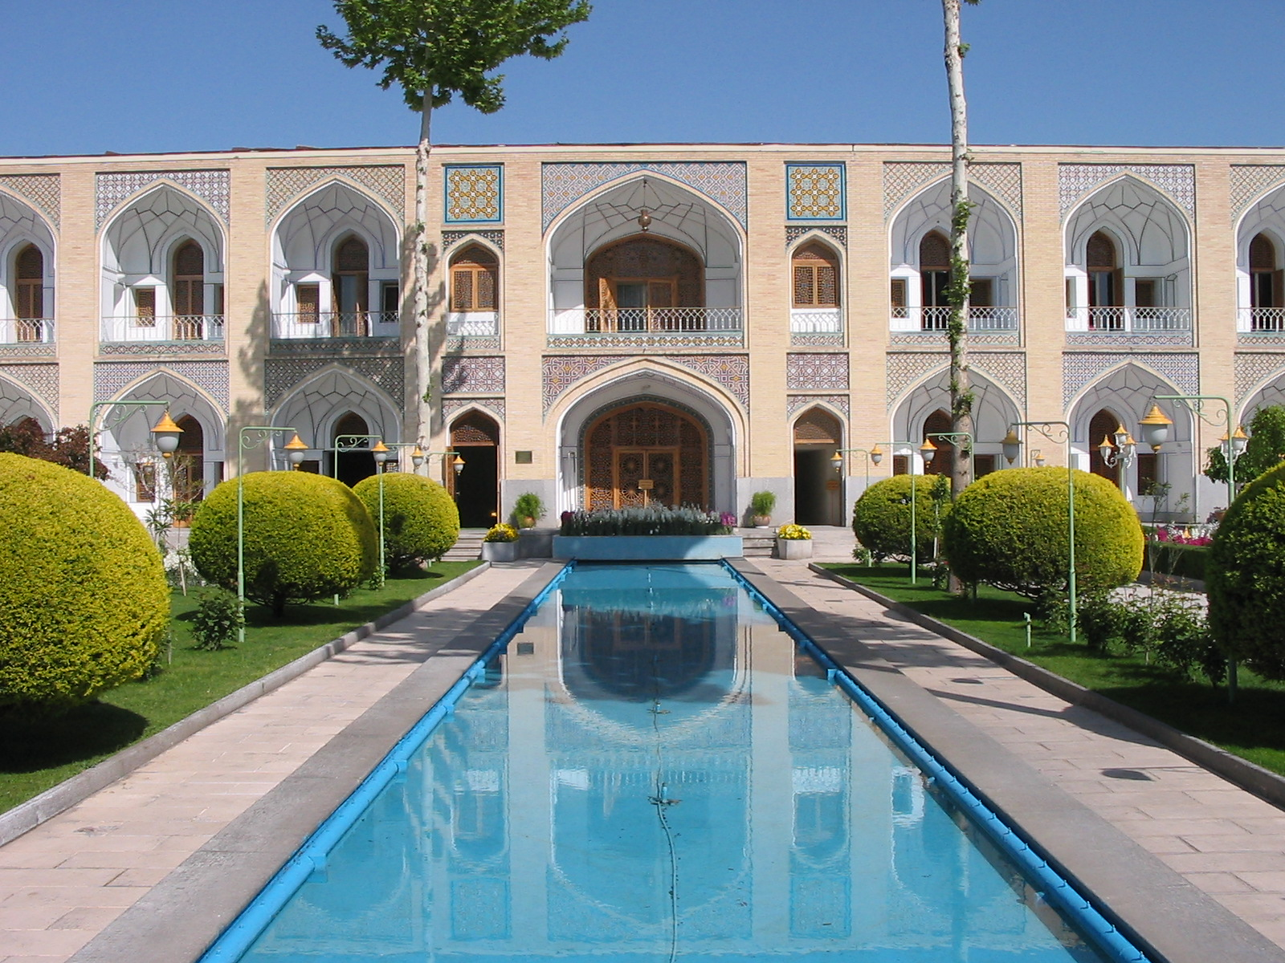
EDA on Hotel Bookings
Hotel Bhuvan
Presented by :Het and Manan Kadia
Guidance by Abhishek sir

Slide 2

Key of contents
Project
Data attributes
Problem statement
Data cleaning process
Data visualization and analysis
conclusion

Slide 3

Project in abridje
1.Project overview :
* Analyze business performance
*time frame :2015 to 2017
2. Data insights :
*Booking details .
* cancellation rate
* Guest demographic
* Food preferences
*origin countries of bookings

Slide 4

3.Data preparation :
cleaning : fill in the missing values , remove duplicates .
Wrangling : organize and format data for analysis.
4. Visualization and reporting :
*use of charts and graphs for enhanced understanding and presentation
5. Comparative Analysis :
city hotel and resort hotel

Slide 5

Data overview
Hotel : types of hotel
Description of column
Market segment
Room type
Customer type
Canceled booking
Booking changes
Total of guest
Date and year

Slide 6

Define the category of hotel

Slide 7
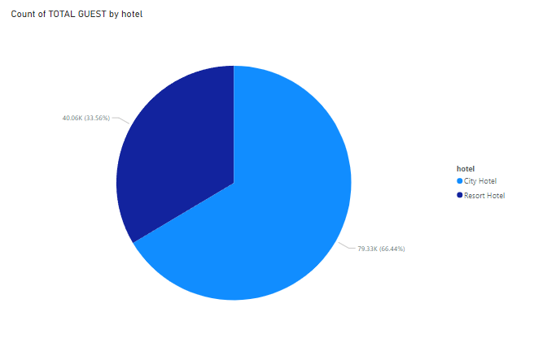
There are two types of hotels here
1st is city hotel
2nd is resort hotel
Count of total guest by hotel
Here this graph indicates that people prefer to stay in city hotels. Booking of a sport hotel is less than that of a city hotel.
We can see total 33.56% peoples choose resort hotel and 66.44 people choose
City hotel.

Slide 8

Define the Customer types

Slide 9
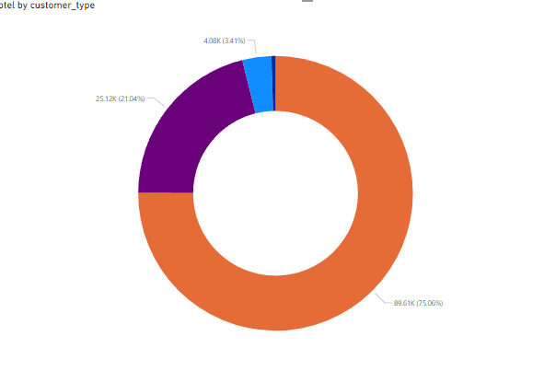
There are 4 types of customers.
TRANSIENT
TRANSIENT PARTY
CONTRACT
GROUP
Let's understand from the Donut chart which type of customer visits the most

Slide 10
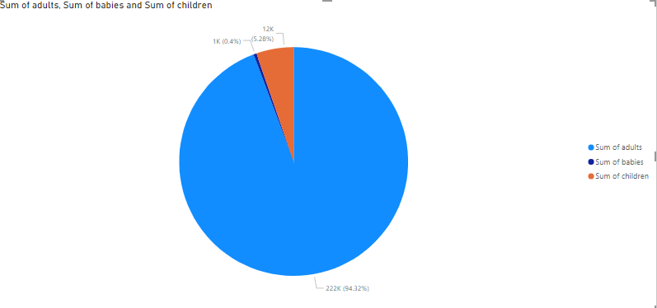
HOW MANY TYPES OF HUMANS ARE THERE AND WHICH HUMANS ARE MORE?
There are 3 types of peoples .
1. Adults
2. Babies
3. Children
Here are 94.32% of Adults .Children are 5.28. We can see that BABS is the lowest at just 0.4%.From this chart it is determined that adults visit the most frequently.

Slide 11
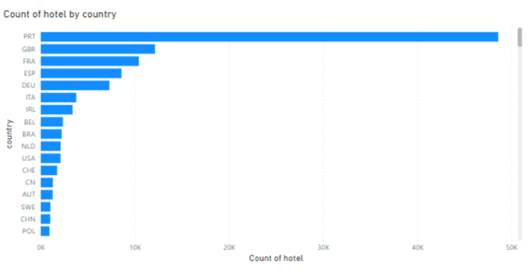
FROM WHICH COUNTRY MORE VISITORS COME TO INDIA?

Slide 12

Here is the use of a colorized chart. Because the number of countries is more.
Visitors from 180 countries come here. Of which the most visitors come from the Portuguese country.After that, more visitors come from the United Kingdom.About 4045 visitors come from Portuguese.

Slide 13
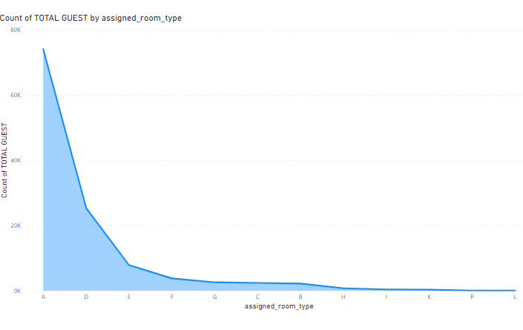
DEFINE THE ROOM TYPE AND IN WHICH ROOM DOES MORE PEOPLES LIVE?
Here A to L types rooms are available.
More peoples choose room no. A because this types room are AC .
And B type room is preferable for customers.

Slide 14


WHICH TYPE OF MEAL CHOOSEN BY GUEST ?

Slide 15
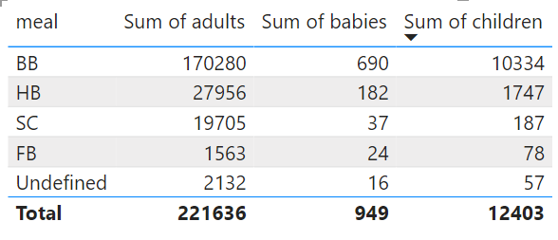
Here matrix is used. By which one can know which type of food is eaten the most. Here, what type of food do children prefer and what type of food do babies and young people prefer? Here we can see that bb food is consumed the most. Young people prefer bb more than children.

Slide 16
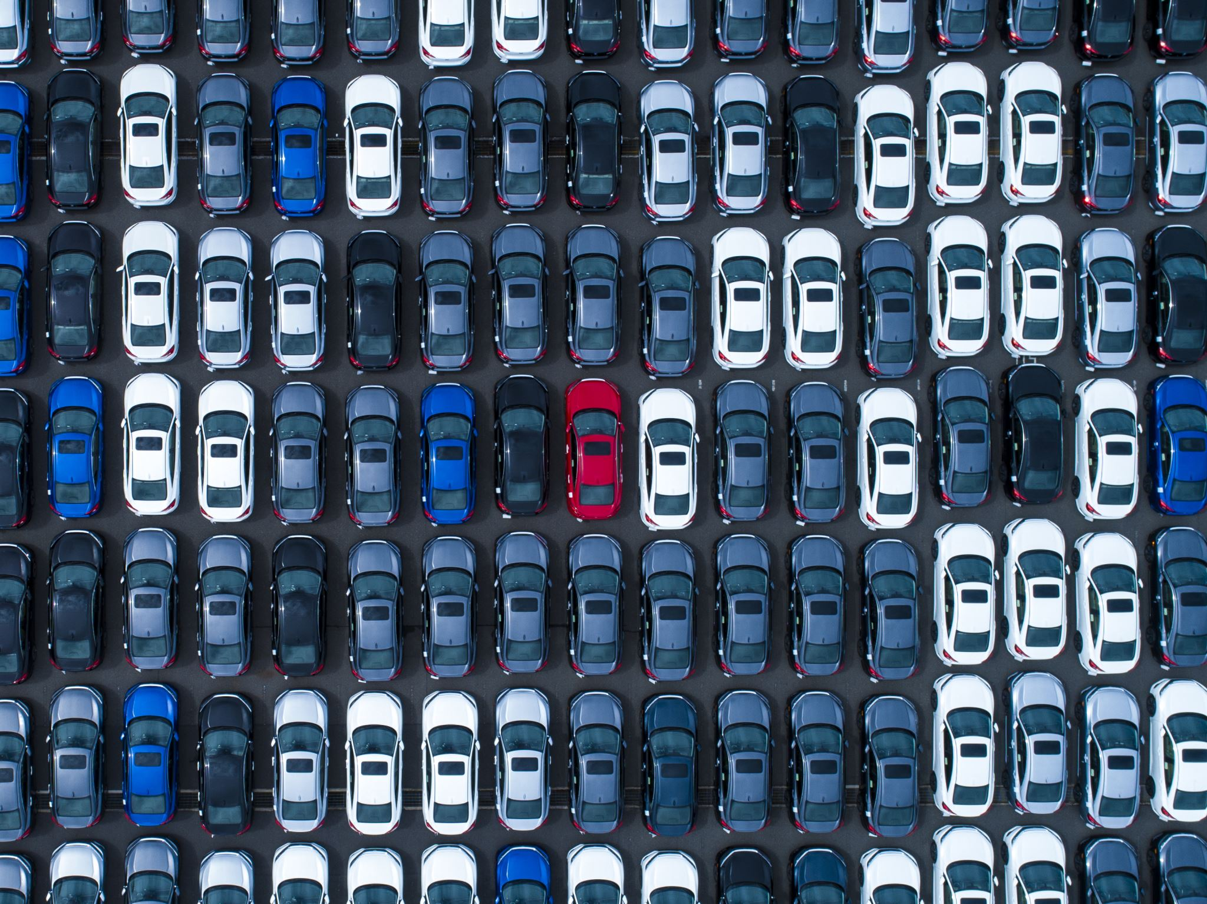
HOW MANY BOOKING REQUIRED CAR PARKING ?

Slide 17
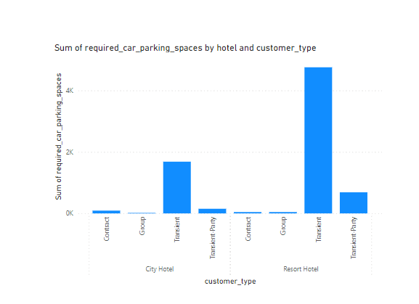
Every type of customer needs car parking here.Out of which the transit type customer has the highest requirement of car parking.
A transport party needs more car parking.

Slide 18
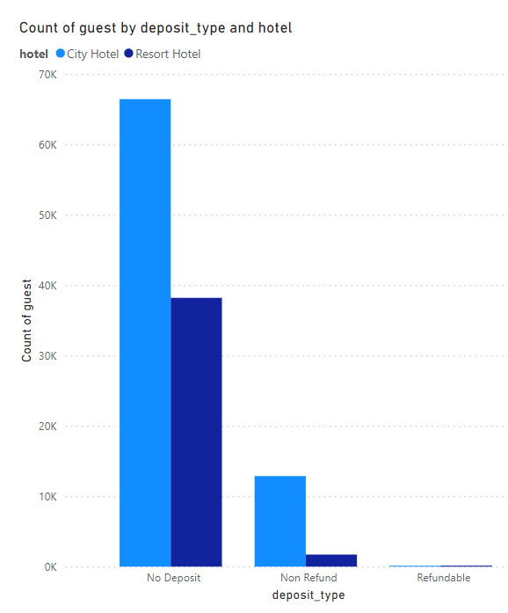
WHICH DEPOSIT TYPE IS MOST COMMONLY CHOOSEN BY GUEST?

Slide 19

Here is the use of clustered column chart. Here is the updated chart showing No Deposit Type is Most Commonly Chosen by Guests and refendable type is Lower Chosen Gussets in City Hotels .

Slide 20

WHICH COUNTRY HAS THE HIGHEST AVERAGE DAILY RATE?

Slide 21
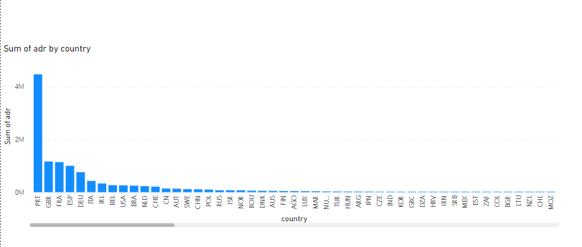
Here total 180 are given ADR the country. Of these, Portuguese has the highest concentration. Then the United Kingdom holds more. France holds 10% less than that.

Slide 22

Conclusion :

Slide 23
*From this project we have compared both from the data of 2 hotels. Among them, city hotel and resort hotel profits are seen.
1.From the first graph it is known that city hotel is more preferred.
2. Young people visit more often.

Slide 24
3. More people come from Portuguese.
4. Room A is used most .Rooms B, C, D are also used more.
5. BB food is consumed more by the youth.
6. Every hotel needs parking. Among them, the transit needs more. If you look at it like this, hotels need car parking.
7. If you look at it this way, this rate of Portuguese is the highest.

Slide 25





Thanks

